Slide 1




Predicting the price of a car
Henrikki Helander

Slide 2
Steps
1
2
3
4
5
DEVELOPMENTENVIRONMENT
COLLECTING DATA
CLEANING DATA
FEATURE ENGINEERING
MACHINE LEARNING

Slide 3
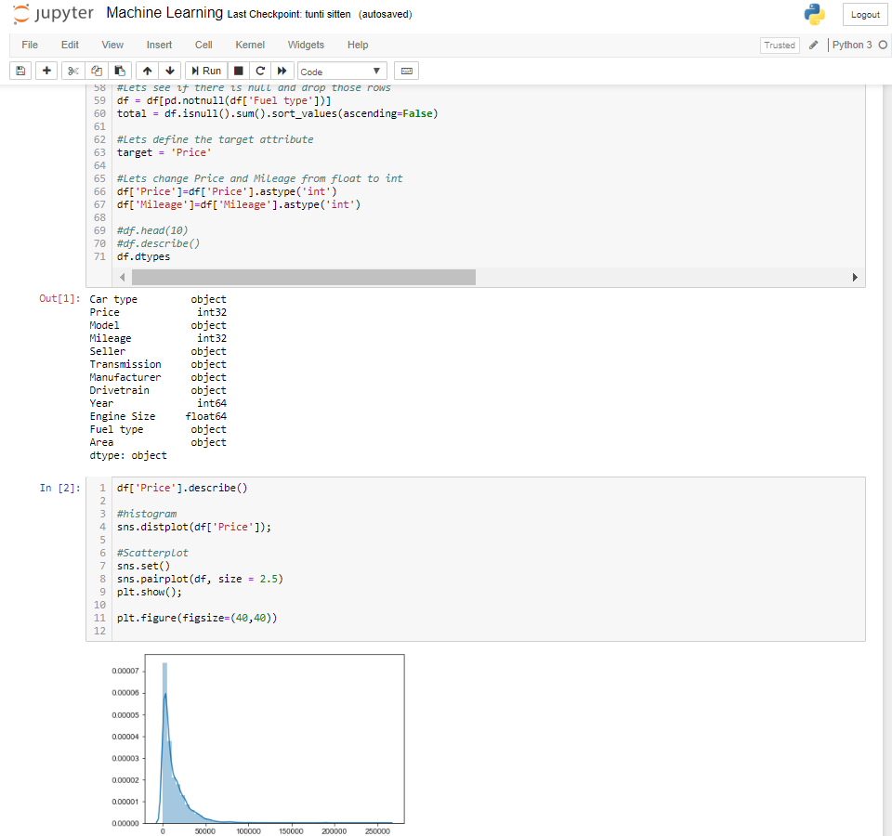


Development environment

Slide 4
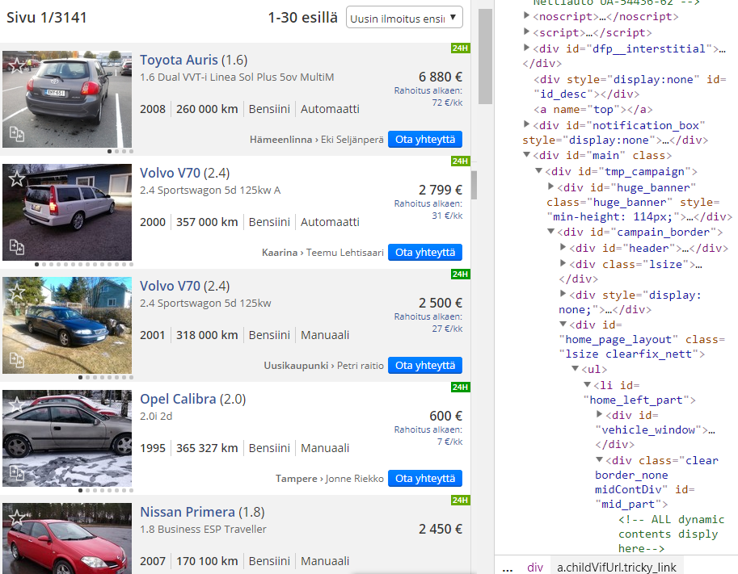
Collecting data
Python build web crawler
Automatically collects data
Saves data to .csv -file

Slide 5
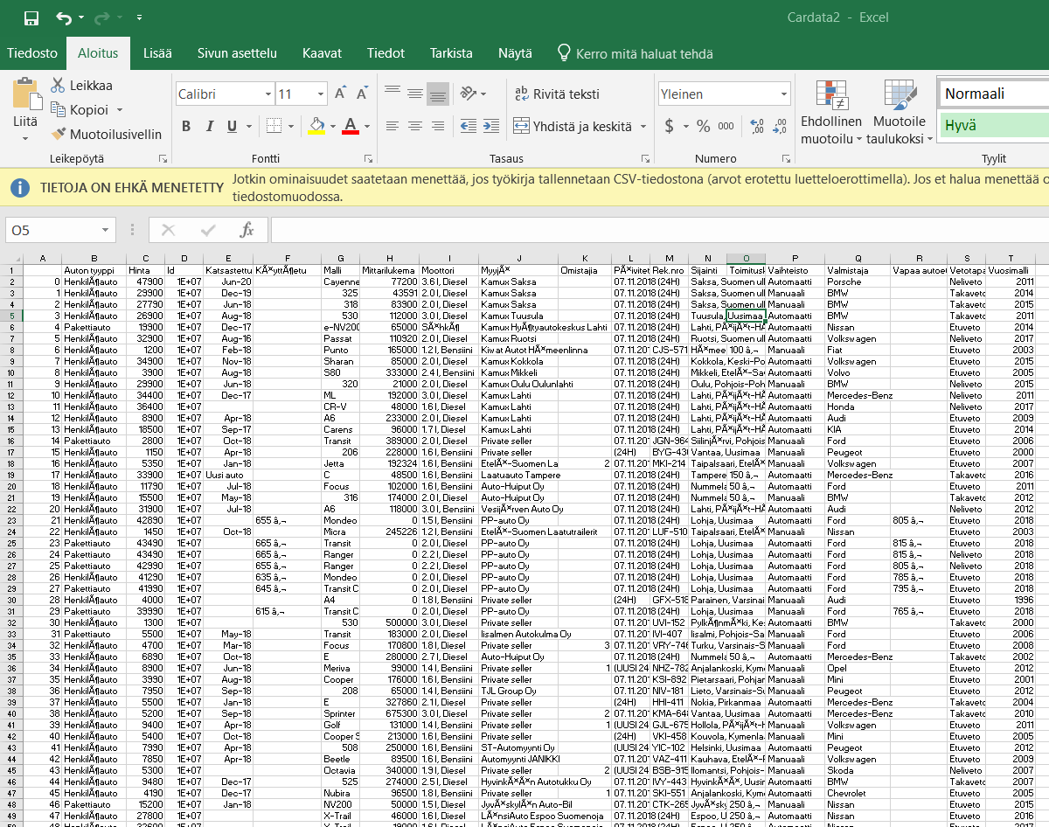
Cleaning data
Read .csv -> Pandas dataframe
Drop useless columns
Modify some:
2.0 l, Diesel -> 2.0 and Diesel
Remove outliers

Slide 6
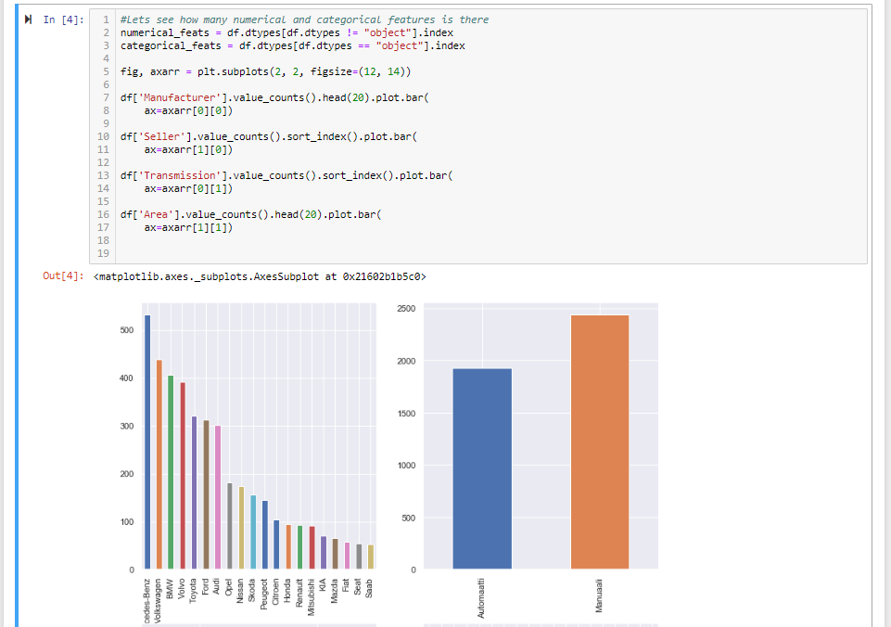

Feature Engineering
First describe data to get understanding about it
Find correlations

Slide 7
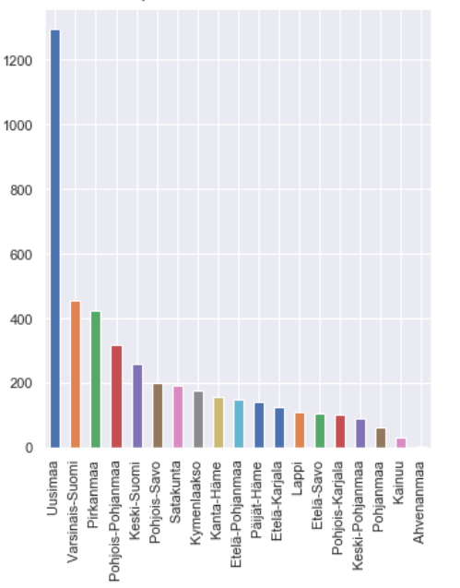
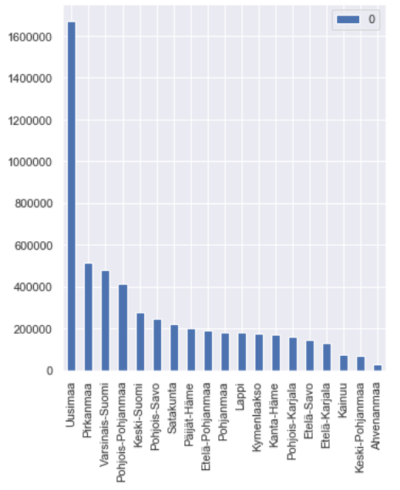
Feature Engineering
Huge correlation between population and amount of car ads
Number of car ads in Area
Population in Area
More people = More car ads

Slide 8
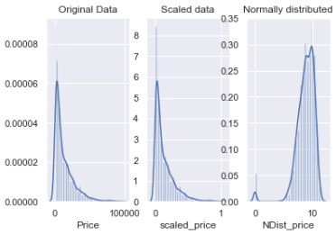
Feature Engineering
Scaling data and normalizing it
Defining features

Slide 9
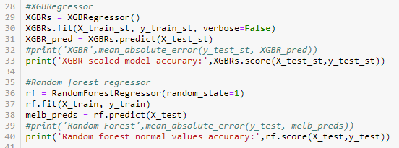
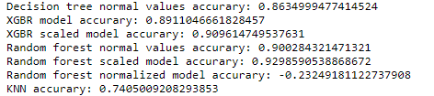
Machine learning
Splitting data to training and testing
Trying different algorithms
Evaluate them

Slide 10






Predicting the price of a car
Transmission
Drivetrain
Mileage
Maker/
Model
52tkm
2015
Engine
Year
Dealer
Fuel type

Slide 11
THANK YOU!
COLLECT
MODIFY
TEACH
1
2
3

